Slide 1
Theory of Computation
ICT 3101
Lecture # 5
Md. Manowarul Islam
Lecturer, Dept of CSE
Jagannath University

Slide 2
Non-deterministic Finite Automata (NFA)
A Non-deterministic Finite Automaton (NFA)
  is of course “non-deterministic”
    Implying that the machine can exist in more than one state at the same time
    Transitions could be non-deterministic
1
q_{j}
q_{i}
…
Each transition function therefore
maps to a set of states
1
q_{k}

Slide 3
Non-deterministic Finite Automata (NFA)
A Non-deterministic Finite Automaton (NFA) consists of:
  Q ==> a finite set of states
  ∑ ==> a finite set of input symbols (alphabet)
  q₀ ==> a start state
  F ==> set of final states
  δ ==> a transition function, which is a mapping between Q x ∑ ==> subset of Q
An NFA is also defined by the 5-tuple:
  {Q, ∑ , q₀,F, δ }

Slide 4
How to use an NFA?
Input: a word w in ∑*
Question: Is w acceptable by the NFA?
Steps:
  Start at the “start state” q₀
  For every input symbol in the sequence w do
    Determine all possible next states from all current states, given the current input symbol in w and the transition function
  If after all symbols in w are consumed and if at least one of the current states is a final state then accept w;
  Otherwise, reject w.

Slide 5

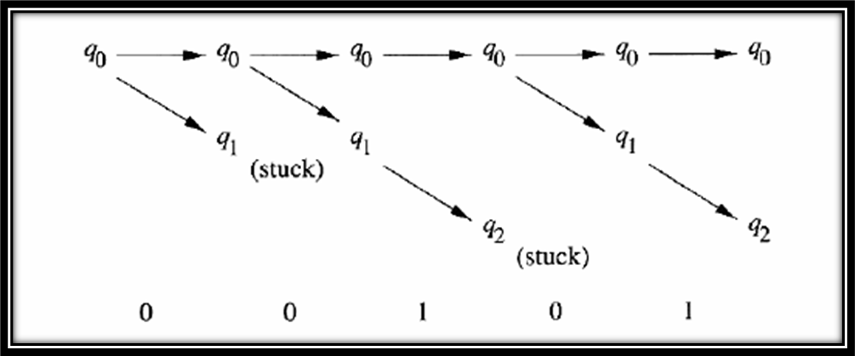
NFA end with 01

Slide 6
NFA for strings containing 01
Regular expression: (0+1)*01(0+1)*
Why is this non-deterministic?
Q = {q₀,q₁,q₂}
Σ = {0,1}
start state = q₀
F = {q₂}
Transition table
0,1
0,1
start
0
1
q₀
q₁
q₂
Final
state
symbols
0
1
What will happen if at state q₁
an input of 0 is received?
q₀
{q₀,q₁}
{q₀}
states
q₁
Φ
{q₂}
*q₂
{q₂}
{q₂}

Slide 7
Example #2
Build an NFA for the following language:
L = { w | w ends in 01}
?
Other examples
  Keyword recognizer (e.g., if, then, else, while, for, include, etc.)
  Strings where the first symbol is present somewhere later on at least once

Slide 8
END

